Slide 1
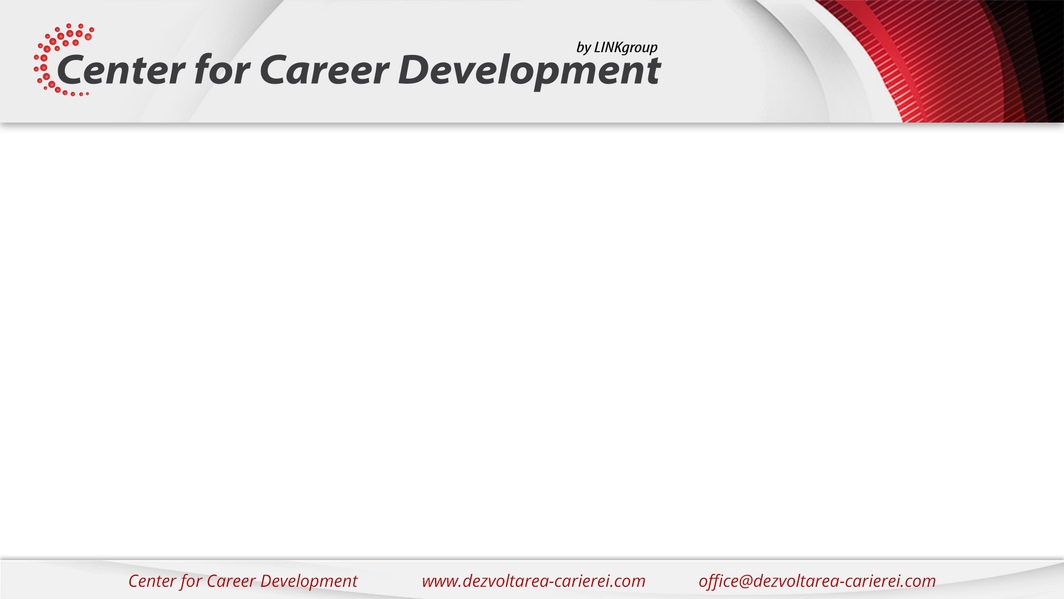
Introduction to Object Oriented Programming
with
J A V A
Remus Sinorchian
Bucuresti – Aprilie 2017

Slide 2

Despre mine
http://rsino.eu
@remussin

Slide 3
Despre mine
Java developer @ Stefanini
Certified Java programmer
Pasionat de tehnologie
Imi plac provocarile
Motto: “Stay hungry, stay foolish!”

Slide 4
Agenda
Ce este Java
Unde este folosit Java
Java – sintaxa de baza
Ce este OOP
OOP in Java – basic
OOP in Java – advanced
Java advanced features

Slide 5
Ce este Java
Dezvoltat in anii ’90 de Sun Microsystems – a ajuns la versiunea 8 , urmeaza in curand 9
Aplicabilitate larga – Java SE, Java EE, multe framework-uri si librarii
Aplicatii desktop
Applets
Applicatii web si enterprise
Big data
Mobile – Android
Dispozitive embedded
Suportat in principalele SO – Windows, Linux, Mac OS, Solaris.
Cross-platform – write once run anywhere
Foarte popular
Foarte cautat

Slide 6
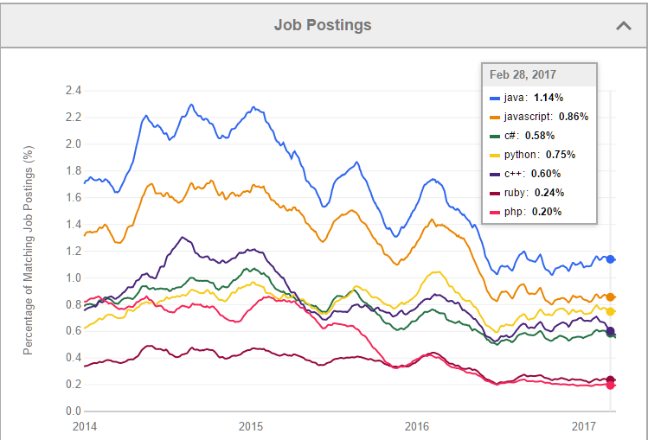
Ce este Java
Sursa: indeed.com

Slide 7
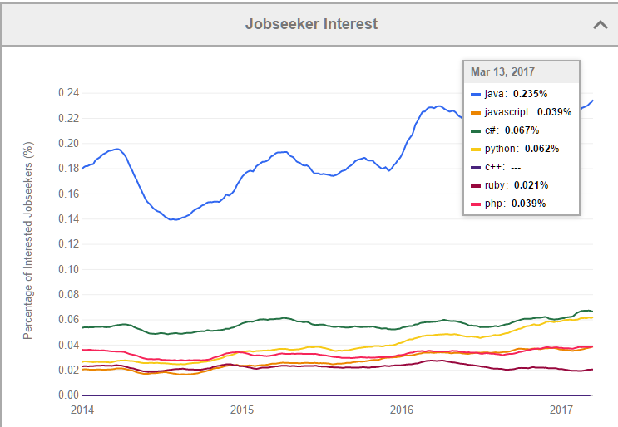
Ce este Java
Sursa: indeed.com

Slide 8
Ce este Java
2 componente
JDK
JRE
Cod sursa - fisiere .java
Cod compilat – fisiere .class → ruleaza in JVM
Pentru a incepe rapid → instaleaza un IDE (IntelliJ IDEA CE)

Slide 9
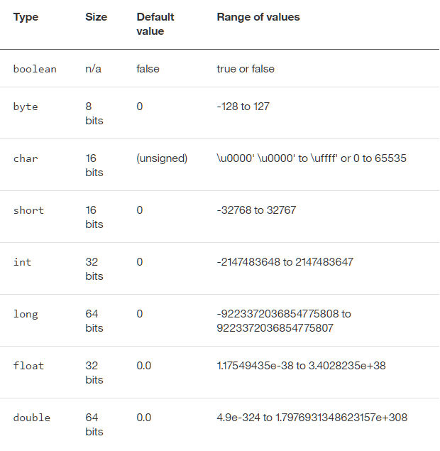
Sitaxa de baza a Java
Scriem Hello world → descrie fisierul Java creat, metoda main; ce se intampla cand compilez si cum rulez?
Ce este o variabila → adaugam o variabila
Tipuri de variabile → primitive, String-uri, vectori
alte tipuri declarate
de programator
Notes:
https://www.ntu.edu.sg/home/ehchua/programming/java/J1a_Introduction.html

Slide 10
Sitaxa de baza a Java
Operatori aritmetici de baza: + , - , * , / , % , etc
Operatori conditionali de baza: > , < , == , != , && , || , !
If , else, else if |
For | → exemple
While |
Clase, metode
Clasa de test cu exemple ce fac anumite calcule care exemplifica operatorii → READ from keayboard input (either with scanner or args)
Notes:
https://www.ntu.edu.sg/home/ehchua/programming/java/J1a_Introduction.html

Slide 11
Ce este OOP
Analogie cu masina
Limbaje procedurale
Programare low level – separa structurile de date si algoritmii
Rata mica de reutilizare
Centrul OOP este clasa
Encapsuleaza proprietatile statice si dinamice si functiile
Usor de reutilizat
Combina structurile de date si algoritmii intr-o singura cutie - abstractizare
Notes:
A car is assembled from parts and components, such as chassis, doors, engine, wheels, brake and transmission. The components are reusable, e.g., a wheel can be used in many cars (of the same specifications).
How about software? Can you "assemble" a software application by picking a routine here, a routine there, and expect the program to run? The answer is obviously NO! Unlike hardware, it is very difficult to "assemble" an application from software components. Since the advent of computer 70 years ago, we have written tons and tons of programs and routines. However, for each new application, we have to re-invent the wheels and write the program from scratch!
Traditional procedural-oriented programming languages (such as C, Fortran, Cobol and Pascal) suffer some notable drawbacks in creating reusable software components:
The procedural-oriented programs are made up of functions. Functions are less reusable.
The procedural languages are not suitable of high-level abstraction for solving real life problems.
The traditional procedural-languages separate the data structures (variables) and algorithms (functions).
Object-oriented programming (OOP) languages are designed to overcome these problems.
The basic unit of OOP is a class, which encapsulates both the static properties and dynamic operations within a "box", and specifies the public interface for using these boxes. Since classes are well-encapsulated, it is easier to reuse these classes. In other words, OOP combines the data structures and algorithms of a software entity inside the same box.
OOP languages permit higher level of abstraction for solving real-life problems. The OOP languages (such as Java, C++ and C#) let you think in the problem space, and use software objects to represent and abstract entities of the problem space to solve the problem.
Object-Oriented technology has many benefits:
Ease in software design as you could think in the problem space rather than the machine's bits and bytes. You are dealing with high-level concepts and abstractions. Ease in design leads to more productive software development.
Ease in software maintenance: object-oriented software are easier to understand, therefore easier to test, debug, and maintain.
Reusable software: you don't need to keep re-inventing the wheels and re-write the same functions for different situations. The fastest and safest way of developing a new application is to reuse existing codes - fully tested and proven codes.

Slide 12
Ce este OOP
Beneficii
Muta atentia pe rezolvarea problemei , nu pe componentele masinii (memorie, bytes, etc)
Usurinta modelarii software-ului - reprezentare pe obiecte – productivitate sporita
Usurinta mentinerii software-ului : codul este mai clar si mai usor de inteles
Rata mare a reutilizarii software-ului

Slide 13
OOP 1
Clasa – descrie un tip si comportamente. Are nume, variabile si metode
Obiectul – este o instanta a clasei
Clasa are variabile, constante, metode si constructori
Metodele au argumente, tip returnat, nume, variabile locale
Un obiect se creeaza folosind unul dintre constructori si cuvantul cheie “New”
O clasa publica trebuie sa fie intr-un fisier cu acelasi nume
Campurile si metodele se acceseaza cu operatorul “.”
Notes:
what is oop? objects and classes; instance variables, methods, constructors; how is memory allocated when you create an object and type NEW. Live coding - think about real world example to build on (Person/Employee/Train station/Book store/Movie store )
Constructors
https://www.ntu.edu.sg/home/ehchua/programming/java/J3a_OOPBasics.html

Slide 14
OOP 2
Encapsulare
Mostenire (inheritance)
Compunere (composition)
Overriding & overloading
Polimorphism
this si super
Variabile statice
Live coding: Regizor, Film, Actor
https://www.ntu.edu.sg/home/ehchua/programming/java/J3f_OOPExercises.html
Notes:
https://www.ntu.edu.sg/home/ehchua/programming/java/J1a_Introduction.html

Slide 15
OOP 3
Clasa abstracta
Interfata
Visibilitate – pachete, clase, metode, variabile
Colectii si generics
Enums
Notes:
Ce este o clasa abstracta? Cand e folosita?
Ce este o interfata si cand e folosita?
Visibilitate – folosim cand vrem sa encapsulam o anumite variabile sau functii , iar pe altele sa le expunem. Putem seta la nivel de clasa, metoda sau variabila

Slide 16
Advanced topics - Java
FILE I/O : exemplu scriere/citire fisier
http://www.drdobbs.com/jvm/java-se-7-new-file-io/231600403
GUI - https://www.ntu.edu.sg/home/ehchua/programming/java/J4a_GUI.html
https://www.jetbrains.com/help/idea/2017.1/creating-and-opening-forms.html
Notes:
https://www.ntu.edu.sg/home/ehchua/programming/java/J1a_Introduction.html

Slide 17
Advanced topics - Java
Exceptii
Comenzile java si javac
Notes:
https://www.ntu.edu.sg/home/ehchua/programming/java/J1a_Introduction.html

Slide 18
Concluzii si urmatorii pasi
Concluzii
Paradigma POO este foarte raspandita si cautata
Java este unul dintre cele mai populare si cautate limbaje de programare
Ofera posibilitati de a lucra in diverse tipuri de aplicatii: desktop, server, web, mobile, embedded
What next?
Urmareste resursele de la bibliografie
Proiect personal sau rezolvarea de probleme – se gasesc pe internet exemple (https://projecteuler.net/)
Urmeaza un curs de Java
Notes:
https://www.ntu.edu.sg/home/ehchua/programming/java/J1a_Introduction.html

Slide 19

Va multumesc
Notes:
https://www.ntu.edu.sg/home/ehchua/programming/java/J1a_Introduction.html

Slide 20
Bibliografie
https://www.ntu.edu.sg/home/ehchua/programming/java/J3a_OOPBasics.html
http://courses.coreservlets.com/Course-Materials/java.html
https://www.ibm.com/developerworks/java/tutorials/j-introtojava1/
https://docs.oracle.com/javase/tutorial/java/concepts/
Codul sursa : https://github.com/RemusSino/java_oop_intro

